Slide 1
2021 ACC/AHA/AATS/STS/SCAI Guideline for Coronary Artery Revascularization
Endorsed by the Society for Cardiovascular Angiography and Interventions

Slide 2
Citation
This slide set is adapted from the 2021 ACC/AHA/AATS/STS/SCAI Guideline for Coronary Artery Revascularization. Published online ahead of print December 3, 2021, available at: Circulation. https://www.ahajournals.org/doi/10.1161/CIR.0000000000001038 and Journal of the American College of Cardiology published online ahead of print December 3, 2021. J Am Coll Cardiol. https://doi.org/10.1016/j.jacc.2021.09.006

Slide 3
2021 Writing Committee Members*
Jennifer S. Lawton, MD, FAHA, Chair†
Jacqueline E. Tamis-Holland, MD, FAHA, FACC, FSCAI, Vice Chair‡
Sripal Bangalore, MD, MHA, FACC, FAHA, FSCAI†
Eric R. Bates, MD, FACC, FAHA†
Theresa M. Beckie, PhD, FAHA†
James M. Bischoff, MEd†
John A. Bittl, MD, FACC†
Mauricio G. Cohen, MD, FACC, FSCAI§
J. Michael DiMaio, MD†
Creighton W. Don, MD, PhD, FACC¶
Stephen E. Fremes, MD, FACC#
Mario F. Gaudino, MD, PhD, MSCE, FACC, FAHA†
Zachary D. Goldberger, MD, FACC, FAHA‡ Michael C. Grant, MD, MSE†
Jang B. Jaswal, MS†
Paul A. Kurlansky, MD, FACC†
Roxana Mehran, MD, FACC†
Thomas S. Metkus, Jr., MD, FACC†
Lorraine C. Nnacheta, DrPH, MPH†
Sunil V. Rao, MD, FACC†
Joseph F. Sabik, MD, FACC||
Frank W. Sellke, MD, FACC, FAHA†
Garima Sharma, MD, FACC†
Celina M. Yong, MD, MBA, MSc, FSCAI, FACC, FAHA†
Brittany A. Zwischenberger, MD†
*Writing committee members are required to recuse themselves from voting on sections to which their specific relationships with industry may apply; see Appendix 1 for detailed information. †ACC/AHA Representative. ‡ACC/AHA Joint Committee on Clinical Practice Guidelines Liaison. § ACC/AHA Task Force on Data Standards Representative. ¶SCAI Representative. #AATS Representative. ||STS representative. **Former Joint Committee member; current member during the writing effort.

Slide 4
Top 10 Take-Home Messages
2021 Guideline for Coronary Artery Revascularization

Slide 5
Top 10 Take Home Messages
1. Treatment decisions with regard to coronary revascularization in patients with coronary artery disease should be based on clinical indications, regardless of sex, race, or ethnicity, because there is no evidence that some patients benefit less than others, and efforts to reduce disparities of care are warranted.

Slide 6
Top 10 Take Home Messages
2. In patients being considered for coronary revascularization for whom the optimal treatment strategy is unclear, a multidisciplinary Heart Team approach is recommended. Treatment decisions should be patient centered, incorporate patient preferences and goals, and include shared decision-making.

Slide 7
Top 10 Take Home Messages
3. For patients with significant left main disease, surgical revascularization is indicated to improve survival relative to that likely to be achieved with medical therapy. Percutaneous revascularization is a reasonable option to improve survival, compared with medical therapy, in selected patients with low to medium anatomic complexity of coronary artery disease and left main disease that is equally suitable for surgical or percutaneous revascularization.

Slide 8
Top 10 Take Home Messages
4. Updated evidence from contemporary trials supplement older evidence with regard to mortality benefit of revascularization in patients with stable ischemic heart disease, normal left ventricular ejection fraction, and triple-vessel coronary artery disease. Surgical revascularization may be reasonable to improve survival. A survival benefit with percutaneous revascularization is uncertain. Revascularization decisions are based on consideration of disease complexity, technical feasibility of treatment, and a Heart Team discussion.

Slide 9
Top 10 Take Home Messages
5. The use of a radial artery as a surgical revascularization conduit is preferred to the use of a saphenous vein conduit to bypass the second most important target vessel with significant stenosis after the left anterior descending coronary artery. Benefits include superior patency, reduced adverse cardiac events, and improved survival.

Slide 10
Top 10 Take Home Messages
6. Radial artery access is recommended in patients undergoing percutaneous intervention who have acute coronary syndromes or stable ischemic heart disease, to reduce bleeding and vascular complications compared with a femoral approach. Patients with acute coronary syndromes also benefit from a reduction in mortality rate with this approach.

Slide 11
Top 10 Take Home Messages
7. A short duration of dual antiplatelet therapy after percutaneous revascularization in patients with stable ischemic heart disease is reasonable to reduce the risk of bleeding events. After consideration of recurrent ischemia and bleeding risks, select patients may safely transition to P2Y12 inhibitor monotherapy and stop aspirin after 1 to 3 months of dual antiplatelet therapy.

Slide 12
Top 10 Take Home Messages
8. Staged percutaneous intervention (while in hospital or after discharge) of a significantly stenosed non-culprit artery in patients presenting with an ST-segment–elevation myocardial infarction is recommended in select patients to improve outcomes. Percutaneous intervention of the non-culprit artery at the time of primary percutaneous coronary intervention is less clear and may be considered in stable patients with uncomplicated revascularization of the culprit artery, low-complexity non-culprit artery disease, and normal renal function. In contrast, percutaneous intervention of the non-culprit artery can be harmful in patients in cardiogenic shock.

Slide 13
Top 10 Take Home Messages
9. Revascularization decisions in patients with diabetes and multivessel coronary artery disease are optimized by the use of a Heart Team approach. Patients with diabetes who have triple-vessel disease should undergo surgical revascularization; percutaneous coronary intervention may be considered if they are poor candidates for surgery.

Slide 14
Top 10 Take Home Messages
10. Treatment decisions for patients undergoing surgical revascularization of coronary artery disease should include the calculation of a patient’s surgical risk with the Society of Thoracic Surgeons score. The usefulness of the SYNTAX score calculation in treatment decisions is less clear because of the interobserver variability in its calculation and its absence of clinical variables.

Slide 15
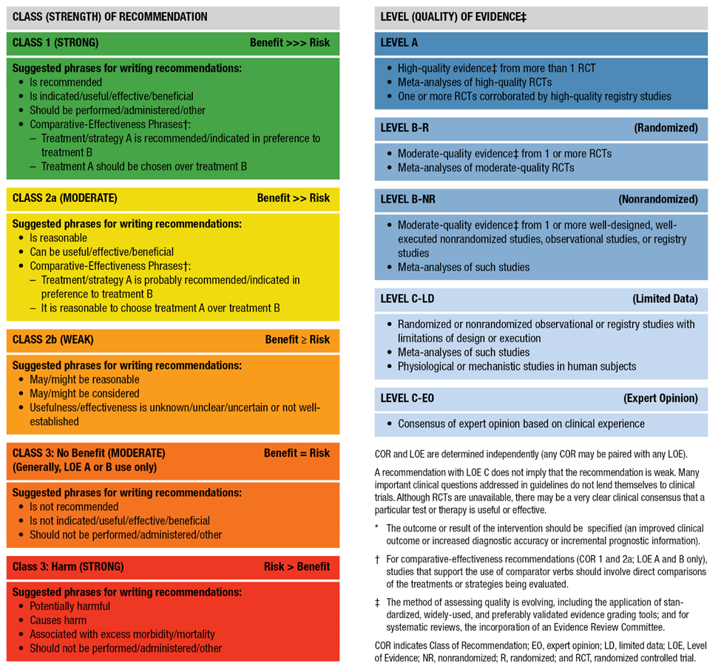
Table 2. Applying Class of Recommendation and Level of Evidence to Clinical Strategies, Interventions, Treatments, or Diagnostic Testing in Patient Care (Updated May 2019)

Slide 16
Improving Equity of Care in Revascularization and Shared Decision-Making

Slide 17
Improving Equity of Care in Revascularization
Recommendation to Improve Equity of Care in Revascularization Referenced studies that support the recommendation are summarized in Online Data Supplement 1.
COR | LOE | Recommendation
1 | B-NR | In patients who require coronary revascularization, treatment decisions should be based on clinical indication, regardless of sex, or race or ethnicity, and efforts to reduce disparities of care are warranted.

Slide 18
Shared Decision-Making and Informed Consent
Recommendations for Shared Decision-Making and Informed Consent
COR | LOE | Recommendations
1 | C-LD | In patients undergoing revascularization, decisions should be patient centered—that is, considerate of the patient’s preferences and goals, cultural beliefs, health literacy, and social determinants of health—and made in collaboration with the patient’s support system .
1 | C-LD | In patients undergoing coronary angiography or revascularization, adequate information about benefits, risks, therapeutic consequences, and potential alternatives in the performance of percutaneous and surgical myocardial revascularization should be given, when feasible, with sufficient time for informed decision-making to improve clinical outcomes.

Slide 19
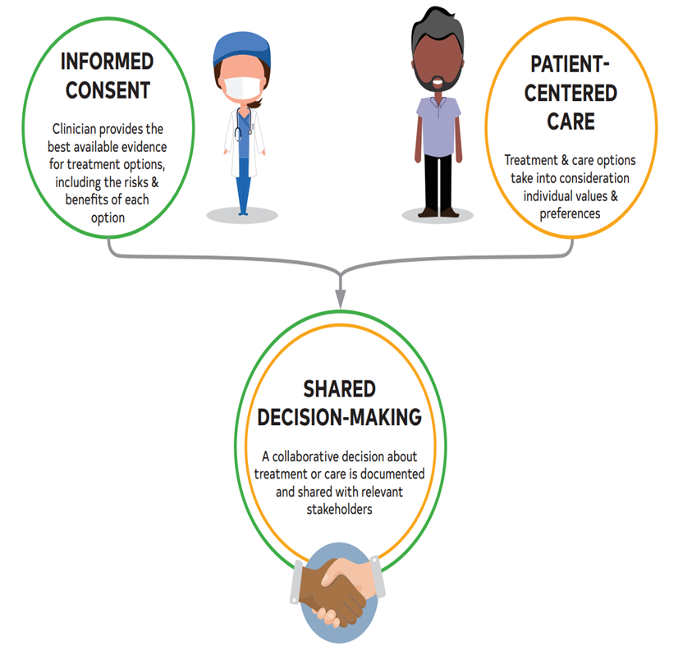
Figure 1. Shared decision-making algorithm.

Slide 20
Table 4. Ideal Components of the Shared Decision-Making and Informed Consent Process
 | Patient-Centered Care
 | Assess a patient’s ability to understand complex health information
 | Seek support of family/others
 | Elicit and respect cultural, racial, ethnic, or religious preferences and values
 | Evaluate social determinants of health (education, income, access to health care)
 | Improve telephone/telemedicine access
 | Discuss treatment alternatives and how each affects the patient’s quality of life

Slide 21
Table 4. Ideal Components of the Shared Decision-Making and Informed Consent Process (con’t.)
 | Shared Decision-Making
 | Encourage questions and explain the patient’s role in the decision-making partnership
 | Clearly and accurately communicate the potential risks and benefits of a particular procedure and alternative treatments
 | Ensure that patients have a key role in deciding what revascularization approach is appropriate
 | Use shared decision aids: Alphabetical List of Decision Aids by Health Topic, Ottawa Hospital Research Institute (https://decisionaid.ohri.ca/implement.html) (27) SHARE Approach Curriculum Tools, Agency for Healthcare Research and Quality (https://www.ahrq.gov/health-literacy/curriculum-tools/shareddecisionmaking/tools/tool-1/index.html) (28)
 | Spend sufficient time to engage in shared decision-making; allow for a second opinion
 | Work with a chaplain, social worker, or other team members to facilitate shared decision-making
 | Encourage patients to share their fears, stress, or other emotions, and address appropriately
 | Negotiate decision in partnership with the patient and family members
 | Respect patient’s autonomy to decline recommended treatment

Slide 22
Table 4. Ideal Components of the Shared Decision-Making and Informed Consent Process (con’t.)
 | Consent Procedures
 | Use plain language, avoiding jargon, and adopt the patient’s words; integrate pictures to teach
 | Document teach-back of patient’s knowledge and understanding
 | Conduct conversations with a trained interpreter, as needed
 | Provide patient-specific short- and long-term risks, benefits, and alternative treatments
 | Provide unbiased, evidence-based, reliable, accessible, and relevant information to patient
 | Discuss specific risks and benefits with regard to survival, relief of angina, quality of life, and potential additional intervention, as well as uncertainties associated with different treatment strategies
 | Provide patient time to reflect on the trade-offs imposed by the outcome estimates
 | Provide information on the level of operator expertise, volume of the facility, and local results in the performance of coronary revascularization options
 | Clearly inform of the need for continued medical therapy and lifestyle modifications

Slide 23
Preprocedural Assessment and the Heart Team

Slide 24
The Heart Team
Recommendation for the Heart Team Referenced studies that support the recommendation are summarized in Online Data Supplement 2.
COR | LOE | Recommendation
1 | B-NR | In patients for whom the optimal treatment strategy is unclear, a Heart Team approach that includes representatives from interventional cardiology, cardiac surgery, and clinical cardiology is recommended to improve patient outcomes.

Slide 25
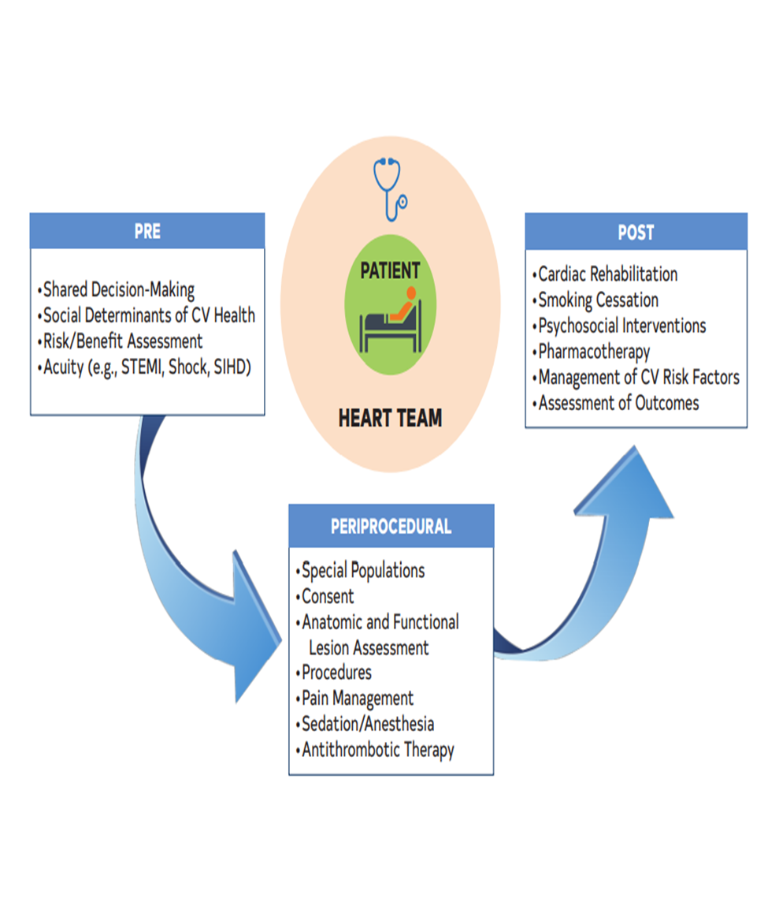
Figure 2. Phases of patient-centric care in the treatment of coronary artery disease.
CV indicates cardiovascular; SIHD, stable ischemic heart disease; and STEMI, ST-segment elevation myocardial infarction.

Slide 26
Table 5. Factors for Consideration by the Heart Team
Coronary Anatomy
Left main disease
Multivessel disease
High anatomic complexity (i.e., bifurcation disease, high SYNTAX score)
Comorbidities
Diabetes
Systolic dysfunction
Coagulopathy
Valvular heart disease
Frailty
Malignant neoplasm End-stage renal disease Chronic obstructive pulmonary disease Immunosuppression Debilitating neurological disorders Liver disease/cirrhosis Prior CVA Calcified/Porcelain aorta Aortic Aneurysm

Slide 27
Table 5. Factors for Consideration by the Heart Team (con’t.)
Procedural Factors
Local and regional outcomes
Access site for PCI
Surgical risk PCI risk
Patient Factors
Unstable presentation or shock Patient preferences Inability or unwillingness to adhere to DAPT Patient social support Religious beliefs Patient education, knowledge, and understanding
DAPT indicates dual antiplatelet therapy; PCI, percutaneous coronary intervention; and SYNTAX, Synergy Between PCI With TAXUS and Cardiac Surgery.

Slide 28
Predicting Patient Risk of Death With CABG
Recommendation for Predicting Patient Risk of Death With CABG Referenced studies that support the recommendation are summarized in Online Data Supplements 3.
COR | LOE | Recommendation
1 | B-NR | In patients who are being considered for CABG, calculation of the Society of Thoracic Surgeons (STS) risk score is recommended to help stratify patient risk.

Slide 29
Table 6. Assessment of Risk Factors Not Quantified in the STS Score
Risk Factor | Assessment Tool
Cirrhosis | Model for End-Stage Liver Disease (MELD)
Frailty | Gait speed
Malnutrition | Malnutrition Universal Screening Tool (MUST)
STS indicates Society of Thoracic Surgeons.

Slide 30
Defining Lesion Severity

Slide 31
Defining Coronary Artery Lesion Complexity: Calculation of the SYNTAX (Synergy Between PCI With TAXUS and Cardiac Surgery) Score
Recommendation for Defining Coronary Artery Lesion Complexity: Calculation of the SYNTAX Score Referenced studies that support the recommendation are summarized in Online Data Supplement 4.
COR | LOE | Recommendation
2b | B-NR | In patients with multivessel CAD, an assessment of CAD complexity, such as the SYNTAX score, may be useful to guide revascularization.

Slide 32
Table 7. Angiographic Features Contributing to Increasing Complexity of CAD
Multivessel disease
Left main or proximal LAD artery lesion
Chronic total occlusion
Trifurcation lesion
Complex bifurcation lesion
Heavy calcification
Severe tortuosity
Aorto-ostial stenosis
Diffusely diseased and narrowed segments distal to the lesion
Thrombotic lesion
Lesion length >20 mm
CAD indicates coronary artery disease; and LAD, left anterior descending.

Slide 33
Use of Coronary Physiology to Guide Revascularization With PCI
Recommendations for the Use of Coronary Physiology to Guide Revascularization With PCI Referenced studies that support the recommendations are summarized in Online Data Supplement 5.
COR | LOE | Recommendations
1 | A | In patients with angina or an anginal equivalent, undocumented ischemia, and angiographically intermediate stenoses, the use of fractional flow reserve (FFR) or instantaneous wave-free ratio (iFR) is recommended to guide the decision to proceed with PCI.
3: No benefit | B-R | In stable patients with angiographically intermediate stenoses and FFR >0.80 or iFR >0.89, PCI should not be performed.

Slide 34
Intravascular Ultrasound to Assess Lesion Severity
Recommendation for Intravascular Ultrasound to Assess Lesion Severity Referenced studies that support the recommendation are summarized in Online Data Supplement 6.
COR | LOE | Recommendation
2a | B-NR | In patients with intermediate stenosis of the left main artery, intravascular ultrasound (IVUS) is reasonable to help define lesion severity.

Slide 35
Revascularization in STEMI

Slide 36
Revascularization of the Infarct Artery in Patients With STEMI
Recommendations for Revascularization of the Infarct Artery in Patients with STEMI Referenced studies that support the recommendations are summarized in Online Data Supplement 7.
COR | LOE | Recommendations
1 | A | In patients with STEMI and ischemic symptoms for <12 hours, PCI should be performed to improve survival.
1 | B-R | In patients with STEMI and cardiogenic shock or hemodynamic instability, PCI or CABG (when PCI is not feasible) is indicated to improve survival, irrespective of the time delay from MI onset.

Slide 37
Revascularization of the Infarct Artery in Patients With STEMI (con’t.)
1 | B-NR | In patients with STEMI who have mechanical complications (e.g., ventricular septal rupture, mitral valve insufficiency because of papillary muscle infarction or rupture, or free wall rupture), CABG is recommended at the time of surgery, with the goal of improving survival.
1 | C- LD | In patients with STEMI and evidence of failed reperfusion after fibrinolytic therapy, rescue PCI of the infarct artery should be performed to improve clinical outcomes.

Slide 38
Revascularization of the Infarct Artery in Patients With STEMI (con’t.)
2a | B-R | In patients with STEMI who are treated with fibrinolytic therapy, angiography within 3 to 24 hours with the intent to perform PCI is reasonable to improve clinical outcomes.
2a | B-NR | In patients with STEMI who are stable and presenting 12 to 24 hours after symptom onset, PCI is reasonable to improve clinical outcomes.
2a | B-NR | In patients with STEMI in whom PCI is not feasible or successful, with a large area of myocardium at risk, emergency or urgent CABG can be effective as a reperfusion modality to improve clinical outcomes.

Slide 39
Revascularization of the Infarct Artery in Patients With STEMI (con’t.)
2a | C-EO | In patients with STEMI complicated by ongoing ischemia, acute severe heart failure, or life-threatening arrhythmia, PCI can be beneficial to improve clinical outcomes, irrespective of time delay from MI onset.
3: No Benefit | B-R | In asymptomatic stable patients with STEMI who have a totally occluded infarct artery >24 hours after symptom onset and are without evidence of severe ischemia, PCI should not be performed (25, 26).
3: Harm | C-EO | In patients with STEMI, emergency CABG should not be performed after failed primary PCI: In the absence of ischemia or a large area of myocardium at risk, or If surgical revascularization is not feasible because of a no-reflow state or poor distal targets.

Slide 40
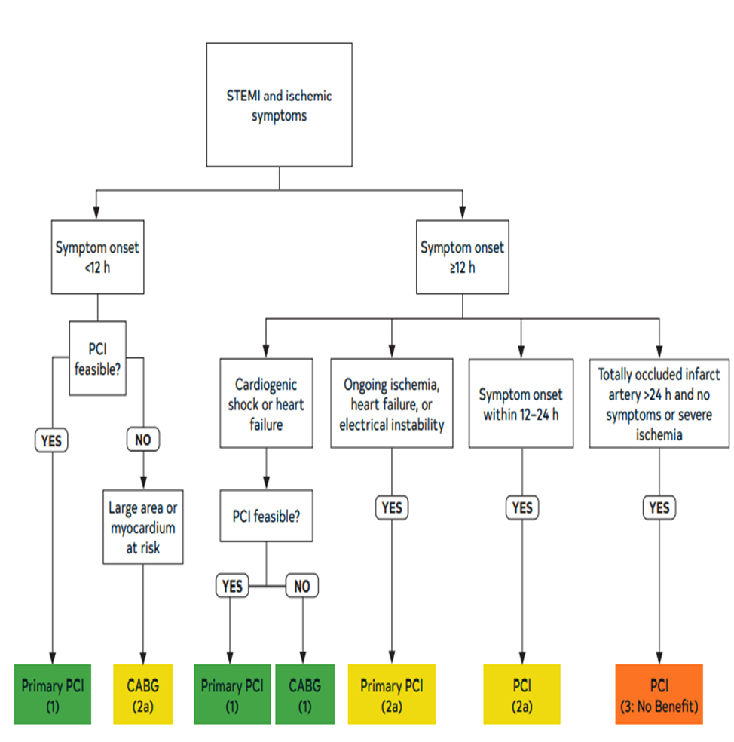
Figure 3. Indications for revascularization in STEMI (patients without fibrinolytics).
Colors correspond to Table 2.
CABG indicates coronary artery bypass graft; PCI, percutaneous coronary intervention; and STEMI, ST-segment elevation myocardial infarction.

Slide 41
Revascularization of the Non-Infarct Artery in Patients With STEMI
Recommendations for Revascularization of the Non-Infarct Artery in Patients With STEMI Referenced studies that support the recommendations are summarized in Online Data Supplement 8.
COR | LOE | Recommendations
1 | A | In selected hemodynamically stable patients with STEMI and multivessel disease, after successful primary PCI, staged PCI of a significant non-infarct artery stenosis is recommended to reduce the risk of death or MI.

Slide 42
Revascularization of the Non-Infarct Artery in Patients With STEMI (con’t.)
2a | C-EO | In selected patients with STEMI with complex multivessel non-infarct artery disease, after successful primary PCI, elective CABG is reasonable to reduce the risk of cardiac events.
2b | B-R | In selected hemodynamically stable patients with STEMI and low-complexity multivessel disease, PCI of a non-infarct artery stenosis may be considered at the time of primary PCI to reduce cardiac event rates.
3: Harm | B-R | In patients with STEMI complicated by cardiogenic shock, routine PCI of a non-infarct artery at the time of primary PCI should not be performed because of the higher risk of death or renal failure.

Slide 43
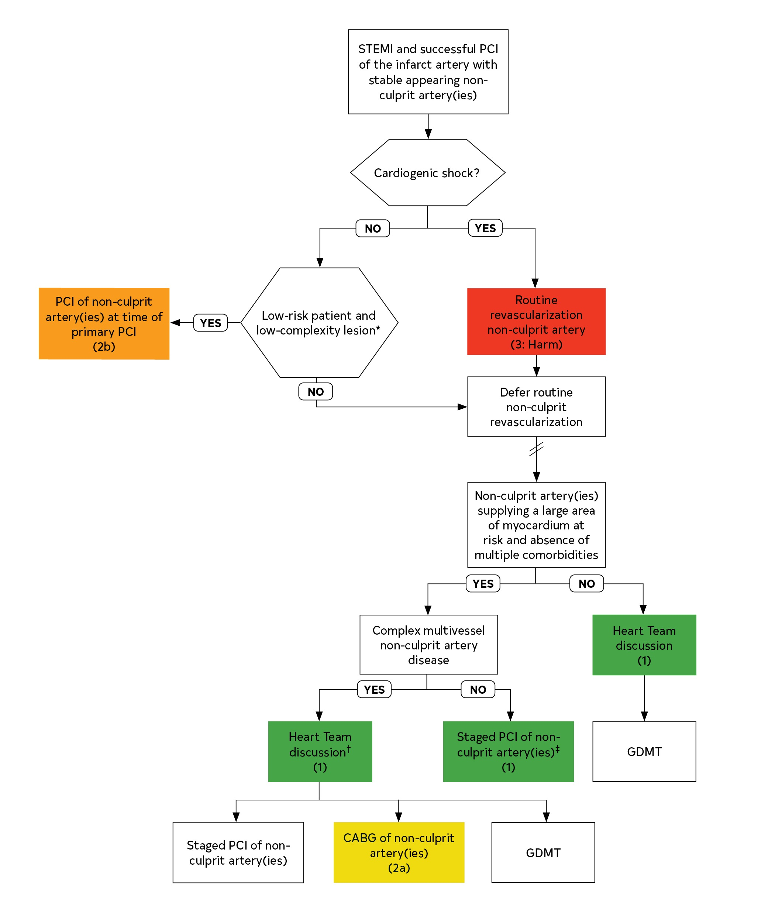
Figure 4. Revascularization of non–infarct-related coronary artery lesions in patients with STEMI.
*Normal blood pressure and heart rate left ventricular end-diastolic pressure ˂20 mmHg, no chronic renal insufficiency or acute kidney injury, and expected total contrast volume ˂3× glomerular filtration rate, simple lesion anatomy.
†In making the decision about the need for and mode of revascularization the Heart Team should consider the suitability of the non-culprit artery for PCI, the coronary complexity and the risk of revascularization, the extent of myocardium at risk, and patient comorbidities, including life expectancy or other significant patient comorbidities, such as chronic renal insufficiency or acute kidney injury.
‡ Staged PCI can be performed in hospital or after discharge, up to 45 days post MI.
Symbol denotes time elapsed before proceeding to the next procedure.
Colors correspond to Table 2.
CABG indicates coronary artery bypass graft; PCI, percutaneous coronary intervention; and STEMI, ST-segment–elevation myocardial infarction.

Slide 44
Table 8. Patient Clinical Status Definitions to Guide Revascularization
Elective | The patient’s cardiac function has been stable in the days or weeks before intervention (whether surgical or procedural). The intervention could be deferred without increased risk of compromise to cardiac outcome.
Urgent | Intervention is required during the same hospitalization to minimize chance of further clinical deterioration. Examples include, but are not limited to, worsening sudden chest pain, heart failure, acute myocardial infarction, anatomy, intra-aortic balloon pump, unstable angina, with intravenous nitroglycerin, or rest angina.

Slide 45
Table 8. Patient Clinical Status Definitions to Guide Revascularization (con’t.)
Emergency | Patients requiring emergency intervention will have ongoing, refractory (difficult, complicated, and/or unmanageable), unrelenting cardiac compromise, with or without hemodynamic instability, and not responsive to any form of therapy except cardiac intervention. An emergency intervention is one in which there should be no delay in providing operative intervention.
Emergency/salvage | Patients requiring emergency/salvage intervention are those who require cardiopulmonary resuscitation en route to the operating room, or procedure room, before induction of anesthesia or who require extracorporeal membrane oxygenation to maintain life.

Slide 46
Revascularization in Non–ST-Segment–Elevation Acute Coronary Syndrome (NSTE-ACS)

Slide 47
Coronary Angiography and Revascularization in Patients with NSTE-ACS
Recommendations for Coronary Angiography and Revascularization in Patients With NSTE-ACS Referenced studies that support the recommendations are summarized in Online Data Supplement 9.
COR | LOE | Recommendations
1 | A | In patients with NSTE-ACS who are at elevated risk of recurrent ischemic events and are appropriate candidates for revascularization, an invasive strategy with the intent to proceed with revascularization is indicated to reduce cardiovascular events.
1 | B-R | In patients with NSTE-ACS and cardiogenic shock who are appropriate candidates for revascularization, emergency revascularization is recommended to reduce risk of death.

Slide 48
Coronary Angiography and Revascularization in Patients with NSTE-ACS (con’t.)
1 | C-LD | In appropriate patients with NSTE-ACS who have refractory angina or hemodynamic or electrical instability, an immediate invasive strategy with intent to perform revascularization is indicated to improve outcomes.
2a | B-R | In patients with NSTE-ACS who are initially stabilized and are at high risk of clinical events, it is reasonable to choose an early invasive strategy (within 24 hours) over a delayed invasive strategy to improve outcomes.
2a | B-R | In patients with NSTE-ACS who are initially stabilized and are at intermediate or low risk of clinical events, an invasive strategy with intent to perform revascularization is reasonable before hospital discharge to improve outcomes.

Slide 49
Coronary Angiography and Revascularization in Patients with NSTE-ACS (con’t.)
2a | B-NR | In patients with NSTE-ACS who have failed PCI and have ongoing ischemia, hemodynamic compromise, or threatened occlusion of an artery with substantial myocardium at risk, who are appropriate candidates for CABG, emergency CABG is reasonable.
3: Harm | B-R | In patients with NSTE-ACS who present in cardiogenic shock, routine multivessel PCI of non-culprit lesions in the same setting should not be performed.

Slide 50
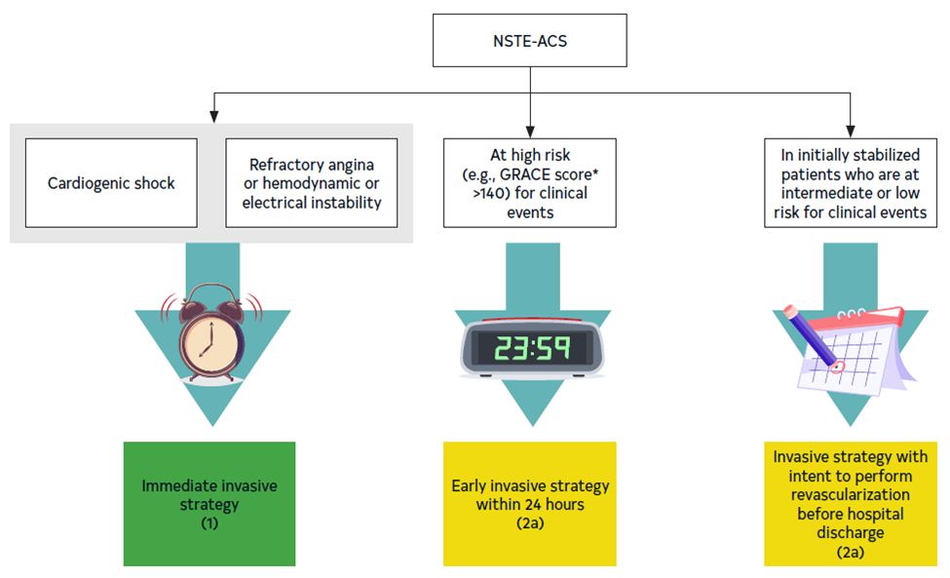
Figure 5. Recommendations for the timing of invasive strategy in patients with NSTE-ACS.
Colors correspond to Table 2.
NSTE-ACS indicates non–ST-segment–elevation acute coronary syndrome.

Slide 51
Revascularization in SIHD

Slide 52
Revascularization to Improve Survival in SIHD Compared With Medical Therapy
Recommendations for Revascularization to Improve Survival in SIHD Compared With Medical Therapy Referenced studies that support the recommendations are summarized in Online Data Supplement 10.
COR | LOE | Recommendations
Left ventricular dysfunction and multivessel CAD
1 | B-R | In patients with SIHD and multivessel CAD appropriate for CABG with severe left ventricular systolic dysfunction (left ventricular ejection fraction <35%), CABG is recommended to improve survival.
2a | B-NR | In selected patients with SIHD and multivessel CAD appropriate for CABG and mild-to-moderate left ventricular systolic dysfunction (ejection fraction 35%–50%), CABG (to include a left internal mammary artery [LIMA] graft to the LAD) is reasonable to improve survival.

Slide 53
Revascularization to Improve Survival in SIHD Compared With Medical Therapy (con’t.)
Left main CAD
1 | B-R | In patients with SIHD and significant left main stenosis, CABG is recommended to improve survival.
2a | B-NR | In selected patients with SIHD and significant left main stenosis for whom PCI can provide equivalent revascularization to that possible with CABG, PCI is reasonable to improve survival.

Slide 54
Revascularization to Improve Survival in SIHD Compared With Medical Therapy (con’t.)
Multivessel CAD
2b | B-R | In patients with SIHD, normal ejection fraction, significant stenosis in 3 major coronary arteries (with or without proximal LAD), and anatomy suitable for CABG, CABG may be reasonable to improve survival.
2b | B-R | In patients with SIHD, normal ejection fraction, significant stenosis in 3 major coronary arteries (with or without proximal LAD), and anatomy suitable for PCI, the usefulness of PCI to improve survival is uncertain.

Slide 55
Revascularization to Improve Survival in SIHD Compared With Medical Therapy (con’t.)
Stenosis in the proximal LAD artery
2b | B-R | In patients with SIHD, normal left ventricular ejection fraction, and significant stenosis in the proximal LAD, the usefulness of coronary revascularization to improve survival is uncertain.
Single- or double-vessel disease not involving the proximal LAD
3: No Benefit | B-R | In patients with SIHD, normal left ventricular ejection fraction, and 1- or 2-vessel CAD not involving the proximal LAD, coronary revascularization is not recommended to improve survival.

Slide 56
Revascularization to Improve Survival in SIHD Compared With Medical Therapy (con’t.)
3: Harm | B-NR | In patients with SIHD who have ≥1 coronary arteries that are not anatomically or functionally significant (<70% diameter of non–left main coronary artery stenosis, FFR >0.80), coronary revascularization should not be performed with the primary or sole intent to improve survival.

Slide 57
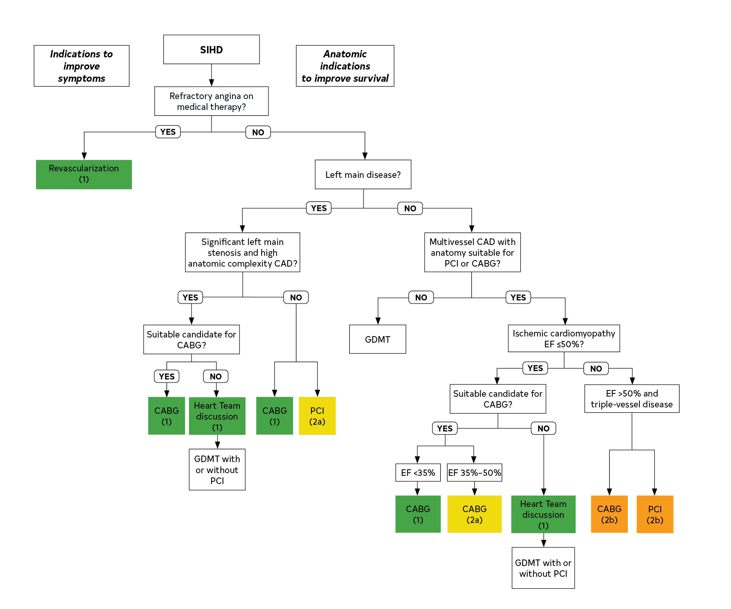
Figure 6. Revascularization in patients with SIHD.
Colors correspond to Table 2.
CABG indicates coronary artery bypass graft; CAD, coronary artery disease; EF, ejection fraction; PCI, percutaneous coronary intervention; SIHD, stable ischemic heart disease; and GDMT, guideline-directed medical therapy.

Slide 58
Revascularization to reduce cardiovascular events in SIHD compared with medical therapy
Recommendations for Revascularization to Reduce Cardiovascular Events in SIHD Compared with Medical Therapy Referenced studies that support the recommendation are summarized in Online Data Supplement 11.
COR | LOE | Recommendations
Multivessel CAD
2a | B-R | In patients with SIHD and multivessel CAD appropriate for either CABG or PCI, revascularization is reasonable to lower the risk of cardiovascular events such as spontaneous MI, unplanned urgent revascularizations, or cardiac death.

Slide 59
Revascularization to Improve Symptoms
Recommendations for Revascularization to Improve Symptoms Referenced studies that support the recommendations are summarized in Online Data Supplement 12.
COR | LOE | Recommendations
1 | A | 1. In patients with refractory angina despite medical therapy and with significant coronary artery stenoses amenable to revascularization, revascularization is recommended to improve symptoms.
3: Harm | C-LD | 2. In patients with angina but no anatomic or physiological criteria for revascularization, neither CABG nor PCI should be performed.

Slide 60
Situations in Which PCI or CABG Would Be Preferred

Slide 61
Patients With Complex Disease
Recommendations for Patients With Complex Disease Referenced studies that support the recommendations are summarized in Online Data Supplement 13.
COR | LOE | Recommendations
1 | B-R | In patients who require revascularization for significant left main CAD with high-complexity CAD, it is recommended to choose CABG over PCI to improve survival.
2a | B-R | In patients who require revascularization for multivessel CAD with complex or diffuse CAD (e.g., SYNTAX score >33), it is reasonable to choose CABG over PCI to confer a survival advantage.

Slide 62
Patients With Diabetes
Recommendations for Patients With Diabetes Referenced studies that support the recommendations are summarized in Online Data Supplement 14.
COR | LOE | Recommendations
1 | A | In patients with diabetes and multivessel CAD with the involvement of the LAD, who are appropriate candidates for CABG, CABG (with a LIMA to the LAD) is recommended in preference to PCI to reduce mortality and repeat revascularizations.
2a | B-NR | In patients with diabetes who have multivessel CAD amenable to PCI and an indication for revascularization and are poor candidates for surgery, PCI can be useful to reduce long-term ischemic outcomes.
2b | B-R | In patients with diabetes who have left main stenosis and low- or intermediate-complexity CAD in the rest of the coronary anatomy, PCI may be considered an alternative to CABG to reduce major adverse cardiovascular outcomes.

Slide 63
Patients With Previous CABG
Recommendations for Patients With Previous CABG Referenced studies that support the recommendations are summarized in Online Data Supplement 15.
COR | LOE | Recommendations
2a | B-NR | In patients with previous CABG with a patent LIMA to the LAD who need repeat revascularization, if PCI is feasible, it is reasonable to choose PCI over CABG.
2a | C-LD | In patients with previous CABG and refractory angina on GDMT that is attributable to LAD disease, it is reasonable to choose CABG over PCI when an internal mammary artery (IMA) can be used as a conduit to the LAD.
2b | B-NR | In patients with previous CABG and complex CAD, it may be reasonable to choose CABG over PCI when an IMA can be used as a conduit to the LAD.

Slide 64
DAPT Adherence
Recommendation for DAPT Adherence Referenced studies that support the recommendation are summarized in Online Data Supplement 16.
COR | LOE | Recommendation
2a | B-NR | In patients with multivessel CAD amenable to treatment with either PCI or CABG who are unable to access, tolerate, or adhere to DAPT for the appropriate duration of treatment, CABG is reasonable in preference to PCI.

Slide 65
Special Populations and Situations

Slide 66
Revascularization in Pregnant Patients
Recommendations for Revascularization in Pregnant Patients Referenced studies that support the recommendations are summarized in Online Data Supplement 17.
COR | LOE | Recommendations
2a | C-LD | In pregnant patients with STEMI not caused by spontaneous coronary artery dissection (SCAD), it is reasonable to perform primary PCI as the preferred revascularization strategy.
2a | C-LD | In pregnant patients with NSTE-ACS, an invasive strategy is reasonable if medical therapy is ineffective for the management of life-threatening complications.

Slide 67
Revascularization in Older Patients
Recommendation for Revascularization in Older Patients Referenced studies that support the recommendation are summarized in Online Data Supplement 18.
COR | LOE | Recommendation
1 | B-NR | In older adults, as in all patients, the treatment strategy for CAD should be based on an individual patient’s preferences, cognitive function, and life expectancy.

Slide 68
Revascularization in Patients With Chronic Kidney Disease (CKD)
Recommendations for Revascularization in Patients With CKD Referenced studies that support the recommendations are summarized in Online Data Supplement 19.
COR | LOE | Recommendations
1 | C-LD | In patients with CKD undergoing contrast media injection for coronary angiography, measures should be taken to minimize the risk of contrast-induced acute kidney injury (AKI).
1 | C-EO | In patients with STEMI and CKD, coronary angiography and revascularization are recommended, with adequate measures to reduce the risk of AKI.

Slide 69
Revascularization in Patients With Chronic Kidney Disease (CKD) (con’t.)
2a | B-NR | In high-risk patients with NSTE-ACS and CKD, it is reasonable to perform coronary angiography and revascularization, with adequate measures to reduce the risk of AKI.
2a | C-EO | In low-risk patients with NSTE-ACS and CKD, it is reasonable to weigh the risk of coronary angiography and revascularization against the potential benefit.
3:No benefit | B-R | In asymptomatic patients with stable CAD and CKD, routine angiography and revascularization are not recommended if there is no compelling indication.

Slide 70
Table 9. Best Practices in the Catheterization Laboratory for Patients With CKD Undergoing Angiography
Assess the risk of contrast-induced AKI before the procedure
Administer adequate preprocedural hydration
Record the volume of contrast media administered, and minimize contrast use
Pretreat with high-intensity statins
Use radial artery if feasible
Do not administer N-acetyl-L-cysteine to prevent contrast-induced AKI
Do not give prophylactic renal replacement therapy
Delay CABG in stable patients after angiography beyond 24 hours when clinically feasible
AKI indicates acute kidney injury; CABG, coronary artery bypass graft; and CKD, chronic kidney disease.

Slide 71
Revascularization in Patients Before Noncardiac Surgery
Recommendation for Revascularization in Patients Before Noncardiac Surgery Referenced studies that support the recommendation are summarized in Online Data Supplement 20.
COR | LOE | Recommendation
3: No benefit | B-R | In patients with non–left main or noncomplex CAD who are undergoing noncardiac surgery, routine coronary revascularization is not recommended solely to reduce perioperative cardiovascular events.

Slide 72
Revascularization in Patients to Reduce Ventricular Arrhythmias
Recommendations for Revascularization in Patients to Reduce Ventricular Arrhythmias Referenced studies that support the recommendations are summarized in Online Data Supplement 21.
COR | LOE | Recommendations
1 | B-NR | In patients with ventricular fibrillation, polymorphic ventricular tachycardia (VT), or cardiac arrest, revascularization of significant CAD is recommended to improve survival.
3: No Benefit | C-LD | In patients with CAD and suspected scar-mediated sustained monomorphic VT, revascularization is not recommended for the sole purpose of preventing recurrent VT.

Slide 73
Revascularization in Patients With SCAD
Recommendations for Revascularization in Patients With SCAD Referenced studies that support the recommendations are summarized in Online Data Supplement 22.
COR | LOE | Recommendations
2b | C-LD | In patients with SCAD who have hemodynamic instability or ongoing ischemia despite conservative therapy, revascularization may be considered if feasible.
3: Harm | C-LD | Routine revascularization for SCAD should not be performed.

Slide 74
Revascularization in Patients With Cardiac Allografts
Recommendation for Revascularization in Patients With Cardiac Allografts
COR | LOE | Recommendation
2a | C-LD | In patients with cardiac allograft vasculopathy and severe, proximal, discrete coronary lesions, revascularization with PCI is reasonable (1, 2).

Slide 75
General Procedural Issues for PCI

Slide 76
Radial and Femoral Approaches for PCI
Recommendations for Radial and Femoral Approaches for PCI Referenced studies that support the recommendations are summarized in Online Data Supplement 23.
COR | LOE | Recommendations
1 | A | In patients with ACS undergoing PCI, a radial approach is indicated in preference to a femoral approach to reduce the risk of death, vascular complications, or bleeding.
1 | A | In patients with SIHD undergoing PCI, the radial approach is recommended to reduce access site bleeding and vascular complications.

Slide 77
Choice of Stent Type
Recommendation for Choice of Stent Type Referenced studies that support the recommendation are summarized in Online Data Supplement 24.
COR | LOE | Recommendation
1 | A | In patients undergoing PCI, DES should be used in preference to BMS to prevent restenosis, MI, or acute stent thrombosis.

Slide 78
Use of Intravascular Imaging
Recommendations for Use of Intravascular Imaging Referenced studies that support the recommendations are summarized in Online Data Supplement 25.
COR | LOE | Recommendations
2a | B-R | In patients undergoing coronary stent implantation, IVUS can be useful for procedural guidance, particularly in cases of left main or complex coronary artery stenting, to reduce ischemic events.
2a | B-R | In patients undergoing coronary stent implantation, OCT is a reasonable alternative to IVUS for procedural guidance, except in ostial left main disease.
2a | C-LD | In patients with stent failure, IVUS or OCT is reasonable to determine the mechanism of stent failure.

Slide 79
Thrombectomy
Recommendation for Thrombectomy Referenced studies that support the recommendation are summarized in Online Data Supplement 26.
COR | LOE | Recommendation
3: No Benefit | A | In patients with STEMI, routine aspiration thrombectomy before primary PCI is not useful.

Slide 80
Treatment of Calcified Lesions
Recommendations for the Treatment of Calcified Lesions Referenced studies that support the recommendations are summarized in Online Data Supplement 27.
COR | LOE | Recommendations
2a | B-R | In patients with fibrotic or heavily calcified lesions, plaque modification with rotational atherectomy can be useful to improve procedural success.
2b | B-NR | In patients with fibrotic or heavily calcified lesions, plaque modification with orbital atherectomy, balloon atherotomy, laser angioplasty, or intracoronary lithotripsy may be considered to improve procedural success.

Slide 81
Treatment of Saphenous Vein Graft (SVG) Disease (Previous CABG)
Recommendations for Treatment of SVG Disease (Previous CABG) Referenced studies that support the recommendations are summarized in Online Data Supplement 28.
COR | LOE | Recommendations
2a | B-R | In select patients with previous CABG undergoing PCI of a SVG, the use of an embolic protection device, when technically feasible, is reasonable to decrease the risk of distal embolization.
2a | B-NR | In patients with previous CABG, if PCI of a diseased native coronary artery is feasible, then it is reasonable to choose PCI of the native coronary artery over PCI of the severely diseased SVG.
3: No Benefit | C-LD | In patients with a chronic occlusion of a SVG, percutaneous revascularization of the SVG should not be performed.

Slide 82
Treatment of CTO
Recommendation for Treatment of CTO Referenced studies that support the recommendation are summarized in Online Data Supplement 29.
COR | LOE | Recommendation
2b | B-R | In patients with suitable anatomy who have refractory angina on medical therapy, after treatment of non-CTO lesions, the benefit of PCI of a CTO to improve symptoms is uncertain.

Slide 83
Treatment of Patients With Stent Restenosis
Recommendations for Treatment of Patients With Stent Restenosis Referenced studies that support the recommendations are summarized in Online Data Supplement 30.
COR | LOE | Recommendations
1 | A | In patients who develop clinical in-stent restenosis (ISR) for whom repeat PCI is planned, a DES should be used to improve outcomes if anatomic factors are appropriate and the patient is able to comply with DAPT.
2a | C-EO | In patients with symptomatic recurrent diffuse ISR with an indication for revascularization, CABG can be useful over repeat PCI to reduce recurrent events.
2b | B-NR | In patients who develop recurrent ISR, brachytherapy may be considered to improve symptoms.

Slide 84
Hemodynamic Support for Complex PCI
Recommendation for Hemodynamic Support in Complex PCI Referenced studies that support the recommendation are summarized in Online Data Supplement 31.
COR | LOE | Recommendation
2b | B-R | In selected high-risk patients, elective insertion of an appropriate hemodynamic support device as an adjunct to PCI may be reasonable to prevent hemodynamic compromise during PCI.

Slide 85
Pharmacotherapy in Patients Undergoing PCI

Slide 86
Aspirin and Oral P2Y12 Inhibitors in Patients Undergoing PCI
Recommendations for Aspirin and Oral P2Y12 Inhibitors in Patients Undergoing PCI Referenced studies that support the recommendations are summarized in Online Data Supplement 32.
COR | LOE | Recommendations
1 | B-R | In patients undergoing PCI, a loading dose of aspirin, followed by daily dosing, is recommended to reduce ischemic events.*
1 | B-R | In patients with ACS undergoing PCI, a loading dose of P2Y12 inhibitor, followed by daily dosing, is recommended to reduce ischemic events.
1 | C-LD | In patients with SIHD undergoing PCI, a loading dose of clopidogrel, followed by daily dosing, is recommended to reduce ischemic events.

Slide 87
Aspirin and Oral P2Y12 Inhibitors in Patients Undergoing PCI (con’t.)
1 | C-LD | In patients undergoing PCI within 24 hours after fibrinolytic therapy, a loading dose of 300 mg of clopidogrel, followed by daily dosing, is recommended to reduce ischemic events.
2a | B-R | In patients with ACS undergoing PCI, it is reasonable to use ticagrelor or prasugrel in preference to clopidogrel to reduce ischemic events, including stent thrombosis.
2b | B-R | In patients <75 years of age undergoing PCI within 24 hours after fibrinolytic therapy, ticagrelor may be a reasonable alternative to clopidogrel to reduce ischemic events.
3: Harm | B-R | In patients undergoing PCI who have a history of stroke or transient ischemic attack, prasugrel should not be administered.

Slide 88
Table 10. Oral and Parental Antiplatelet Agents for Patients Undergoing PCI
Drug | Loading Dose | Maintenance Dose
Oral antiplatelet agents
Aspirin | Loading dose of 162-325 mg orally Aspirin may be chewed to achieve faster action | Maintenance dose of 75-100 mg orally daily
Clopidogrel | Loading dose of 600 mg orally A lower loading dose of 300 mg should be considered in patients after fibrinolytic therapy | Maintenance dose of 75 mg orally daily
Prasugrel | Loading dose of 60 mg orally | Maintenance dose of 10 mg orally daily In patients with body weight <60 kg, a maintenance dose of 5 mg orally daily is recommended In patients ≥75 years of age, a dose of 5 mg orally daily can be used if deemed necessary

Slide 89
Table 10. Oral and Parental Antiplatelet Agents for Patients Undergoing PCI (con’t.)
Ticagrelor | Loading dose of 180 mg orally Ticagrelor may be chewed to achieve faster action | Maintenance dose of 90 mg orally twice a day
Intravenous antiplatelet agents
Abciximab (GPI)* | Bolus of 0.25 mg/kg | Maintenance of 0.125 µg/kg/min infusion (maximum 10 g/min) for 12 h.
Eptifibatide (GPI) | Double bolus of 180 µg/kg (given at a 10-min interval) | Maintenance infusion of 2.0 µg/kg/min for up to 18 h
Tirofiban (GPI) | Bolus of 25 µg/kg over 3 min | Maintenance infusion of 0.15 µg/kg/min for up to 18 h
Cangrelor | Bolus of 30 µg/kg | Maintenance infusion 4 µg/kg/min for at least 2 h or duration of the procedure, whichever is longer
GPI indicates glycoprotein IIb/IIIa inhibitor; and PCI, percutaneous coronary intervention.
*Abciximab may not be readily available to clinicians in the U.S.

Slide 90
Intravenous P2Y12 Inhibitors in Patients Undergoing PCI
Recommendation for Intravenous P2Y12 Inhibitors in Patients Undergoing PCI Referenced studies that support the recommendation are summarized in Online Data Supplement 33.
COR | LOE | Recommendation
2b | B-R | In patients undergoing PCI who are P2Y12 inhibitor naïve, intravenous cangrelor may be reasonable to reduce periprocedural ischemic events.

Slide 91
Intravenous Glycoprotein IIb/IIIa Inhibitors in Patients Undergoing PCI
Recommendations for Glycoprotein IIb/IIIa Inhibitors in Patients Undergoing PCI Referenced studies that support the recommendations are summarized in Online Data Supplement 34.
COR | LOE | Recommendations
2a | C-LD | In patients with ACS undergoing PCI with large thrombus burden, no-reflow, or slow flow, intravenous glycoprotein IIb/IIIa inhibitor agents are reasonable to improve procedural success.
3: No Benefit | B-R | In patients with SIHD undergoing PCI, the routine use of an intravenous glycoprotein IIb/IIIa inhibitor agent is not recommended.

Slide 92
Heparin, Low-Molecular-Weight Heparin, and Bivalirudin in Patients Undergoing PCI
Recommendations for Heparin, Low-Molecular-Weight Heparin, and Bivalirudin in Patients Undergoing PCI Referenced studies that support the recommendations are summarized in Online Data Supplement 35.
COR | LOE | Recommendations
1 | C-EO | In patients undergoing PCI, administration of intravenous unfractionated heparin (UFH) is useful to reduce ischemic events.
1 | C-LD | In patients with heparin-induced thrombocytopenia undergoing PCI, bivalirudin or argatroban should be used to replace UFH to avoid thrombotic complications.

Slide 93
Heparin, Low-Molecular-Weight Heparin, and Bivalirudin in Patients Undergoing PCI (con’t.)
2b | A | In patients undergoing PCI, bivalirudin may be a reasonable alternative to UFH to reduce bleeding.
2b | B-R | In patients treated with upstream subcutaneous enoxaparin for unstable angina or NSTE-ACS, the use of intravenous enoxaparin may be considered at the time of PCI to reduce ischemic events.
3: Harm | B-R | In patients on therapeutic subcutaneous enoxaparin, in whom the last dose was administered within 12 hours of PCI, UFH should not be used for PCI and may increase bleeding.

Slide 94
Table 11. Anticoagulant Dosing During PCI*
Dosing of Parenteral Anticoagulants During PCI
Drug | Patient Has Received Previous Anticoagulant Therapy | Patient Has Not Received Previous Anticoagulant Therapy
UFH | Additional UFH as needed (e.g., 2000–5000 U) to achieve an ACT of 250-300 s* | 70–100 U/kg initial bolus to achieve target ACT of 250–300 s*
Enoxaparin | For previous treatment with enoxaparin, if the last SC dose was administered 8–12 h earlier or if only 1 SC dose of enoxaparin has been administered, an IV dose of 0.3 mg/kg of enoxaparin should be given If the last SC dose was administered within the previous 8 h, no additional enoxaparin should be given | 0.5–0.75 mg/kg IV bolus

Slide 95
Table 11. Anticoagulant Dosing During PCI* (con’t.)
Bivalirudin | For patients who have received UFH, repeat ACT If ACT is not in therapeutic range, then give 0.75 mg/kg IV bolus, then 1.75 mg/kg/h IV infusion | 0.75 mg/kg bolus, 1.75 mg/kg/h IV infusion
Argatroban | 200 µg/kg IV bolus, then 15 µg/kg/min IV infusion | 350 µg/kg, then 15 µg/kg/min IV infusion
*Target ACTs for UFH dosing shown for HemoTec (GmbH, Switzerland) or I-Stat (Abbott) device. For Hemochron ACT (Werfen) devices, ACT goals are 50 s higher. In the case of CTO or ACS, consider higher target ACT. If IV glycoprotein IIb/IIIa receptor inhibitor is planned, target ACT 200–250 s. ACS indicates acute coronary syndrome; ACT, activated clotting time; CTO, chronic total occlusion; IV, intravenous; PCI, percutaneous coronary intervention; SC, subcutaneous; and UFH, unfractionated heparin.

Slide 96
General Procedural Issues for CABG

Slide 97
Perioperative Considerations in Patients Undergoing CABG
Recommendation for Perioperative Considerations in Patients Undergoing CABG Referenced studies that support the recommendation are summarized in Online Data Supplement 36.
COR | LOE | Recommendation
1 | B-NR | For patients undergoing CABG, establishment of multidisciplinary, evidence-based perioperative management programs is recommended to optimize analgesia, minimize opioid exposure, prevent complications and to reduce time to extubation, length of stay, and healthcare costs.

Slide 98
Table 12. Perioperative Anesthetic and Monitoring Considerations for CABG
Anesthetic considerations
Perioperative analgesia | Nonopioid medications (e.g., acetaminophen, ketamine, dexmedetomidine) and/or regional techniques (e.g., truncal nerve blocks), particularly as part of a multimodal analgesic approach, have been shown to reduce perioperative opioid use in cardiac surgery.
Maintenance anesthesia | Although volatile (versus intravenous) anesthesia may facilitate earlier extubation, recent evidence suggests that the choice of maintenance anesthetic likely does not impact mortality rate after cardiac surgery.
Mechanical ventilation | An intraoperative lung-protective ventilation strategy (i.e., tidal volume of 6–8 mL/kg predicted body weight + positive end-expiratory pressure) has been shown to improve pulmonary mechanics and reduce postoperative pulmonary complications.
Goal-directed therapy | Goal-directed therapy, which creates protocols for the use of fluids and vasopressors to target specific hemodynamic goals, has yielded inconsistent results and requires additional investigation to determine its use in cardiac surgery.

Slide 99
Table 12. Perioperative Anesthetic and Monitoring Considerations for CABG (con’t.)
TEE
CABG + valve procedures | Intraoperative TEE aids in the real-time assessment of heart valve function and pathology in those undergoing combination CABG and valve surgery.
Isolated CABG procedures | The use of intraoperative TEE in isolated CABG is less established but has been shown to aid in surgical and anesthetic decision-making as a tool for real-time assessment of hemodynamic status, regional wall motion, ventricular function, valve anatomy, and diastolic function.
Pulmonary artery catheters
High-risk surgery | Highly selective use of pulmonary artery catheters for high-risk patients (i.e., older, with congestive heart failure, pulmonary hypertension, or previous multiple valve procedures) may be safe and may potentially aid in the surveillance and treatment of hemodynamic instability.
Low-risk surgery | The use of pulmonary artery catheters in low-risk or clinically stable patients is discouraged because the practice is associated with increased interventions that incur greater healthcare expense without associated improvement in morbidity or mortality.

Slide 100
Table 12. Perioperative Anesthetic and Monitoring Considerations for CABG (con’t.)
CNS monitoring
Cerebral oxygen saturation | Intraoperative monitoring of cerebral oxygen saturation (i.e., near-infrared spectroscopy) to detect cerebral hypoperfusion has been shown to guide anesthetic decision-making and may prevent postoperative neurocognitive dysfunction.
Processed electroencephalogram | Routine use of intraoperative monitoring of processed electroencephalogram (i.e., bispectral index) has yielded inconsistent results with respect to the prevention of recall, determination of depth of anesthesia, or improvement in rate of recovery after cardiac surgery.
CABG indicates coronary artery bypass graft; CNS, central nervous system; and TEE, transesophageal echocardiography.

Slide 101
Bypass Conduits in Patients Undergoing CABG
Recommendations for Bypass Conduits in Patients Undergoing CABG Referenced studies that support the recommendations are summarized in Online Data Supplement 37.
COR | LOE | Recommendations
1 | B-R | In patients undergoing isolated CABG, the use of a radial artery is recommended in preference to a saphenous vein conduit to graft the second most important, significantly stenosed, non–LAD vessel to improve long-term cardiac outcomes.
1 | B-NR | In patients undergoing CABG, an IMA, preferably the left, should be used to bypass the LAD when bypass of the LAD is indicated to improve survival and reduce recurrent ischemic events.
2a | B-NR | In patients undergoing CABG, bilateral IMA (BIMA) grafting by experienced operators can be beneficial in appropriate patients to improve long-term cardiac outcomes.

Slide 102
Table 13. Best Practices for the Use of Bypass Conduits in CABG
Objectively assess palmar arch completeness and ulnar compensation before harvesting the radial artery. Use the arm with the best ulnar compensation for radial artery harvesting.
Use radial artery grafts to target vessels with subocclusive stenoses.
Avoid the use of the radial artery after transradial catheterization.
Avoid the use of the radial artery in patients with chronic kidney disease and a high likelihood of rapid progression to hemodialysis.
Use oral calcium channel blockers for the first postoperative year after radial artery grafting.
Avoid bilateral percutaneous or surgical radial artery procedures in patients with coronary artery disease to preserve the artery for future use.
Harvest the internal mammary artery using the skeletonization technique to reduce the risk of sternal wound complications.
Use an endoscopic saphenous vein harvest technique in patients at risk of wound complications.
Use a no-touch saphenous vein harvest technique in patients at low risk of wound complications.
Use the skeletonized right gastroepiploic artery to graft right coronary artery target vessels with subocclusive stenosis if the operator is experienced with the use of the artery.
CABG indicates coronary artery bypass graft.

Slide 103
CABG in Patients Undergoing Other Cardiac Surgery
Recommendations for CABG in Patients Undergoing Other Cardiac Surgery Referenced studies that support the recommendations are summarized in Online Data Supplement 38.
COR | LOE | Recommendations
1 | C-LD | In patients undergoing valve surgery, aortic surgery, or other cardiac operations who have significant CAD, CABG is recommended with a goal of reducing ischemic events.
2b | C-LD | In patients undergoing valve surgery, aortic surgery, or other cardiac operations who have intermediate CAD, CABG may be reasonable with a goal of reducing ischemic events.

Slide 104
Use of Epiaortic Ultrasound in Patients Undergoing CABG
Recommendation for Use of Epiaortic Ultrasound in Patients Undergoing CABG Referenced studies that support the recommendation are summarized in Online Data Supplement 39.
COR | LOE | Recommendation
2a | B-NR | In patients undergoing CABG, the routine use of epiaortic ultrasound scanning can be useful to evaluate the presence, location, and severity of plaque in the ascending aorta to reduce the incidence of atheroembolic complications.

Slide 105
Use of Cardiopulmonary Bypass in Patients Undergoing CABG
Recommendations for Use of Cardiopulmonary Bypass in Patients Undergoing CABG Referenced studies that support the recommendations are summarized in Online Data Supplement 40.
COR | LOE | Recommendations
2a | B-R | In patients with significant calcification of the aorta, the use of techniques to avoid aortic manipulation (off-pump techniques or beating heart) is reasonable to decrease the incidence of perioperative stroke when performed by experienced surgeons.
2b | B-R | In patients with significant pulmonary disease, off-pump surgery may be reasonable to reduce perioperative risk when performed by experienced surgeons.

Slide 106
Pharmacotherapy in Patients Undergoing CABG

Slide 107
Insulin Infusion and Other Measures to Reduce Sternal Wound Infection in Patients Undergoing CABG
Recommendations for Insulin Infusion and Other Measures to Reduce Sternal Wound Infection in Patients Undergoing CABG Referenced studies that support the recommendations are summarized in Online Data Supplement 41.
COR | LOE | Recommendations
1 | B-R | In patients undergoing CABG, an intraoperative continuous insulin infusion should be initiated to maintain serum glucose level <180 mg/dL to reduce sternal wound infection.

Slide 108
Insulin Infusion and Other Measures to Reduce Sternal Wound Infection in Patients Undergoing CABG (con’t.)
1 | B-R | In patients undergoing CABG, the use of continuous intravenous insulin to achieve and maintain an early postoperative blood glucose concentration of <180 mg/dL while avoiding hypoglycemia is indicated to reduce the incidence of adverse events, including deep sternal wound infection.
1 | B-NR | In patients undergoing CABG, a comprehensive approach to reduce sternal wound infection is recommended.
2b | B-R | In patients undergoing CABG, the usefulness of continuous intravenous insulin designed to achieve a target intraoperative blood glucose concentration <140 mg/dL is uncertain.

Slide 109
Table 15. Best Practices to Reduce Sternal Wound Infection in Patients Undergoing CABG
Perform nasal swab testing for Staphylococcus aureus. Apply mupirocin 2% ointment to known nasal carriers of S aureus.
Apply preoperative intranasal mupirocin 2% ointment to those patients whose nasal culture or PCR result is unknown.
Redose prophylactic antimicrobials for long procedures (>2 half-lives of the antibiotic) or in cases of excessive blood loss during CABG.
Measure perioperative HbA_{1c}.
Treat all distant extrathoracic infections before nonemergency surgical coronary revascularization.
Advise smoking cessation before elective CABG surgery.
Apply topical antibiotics (vancomycin) to the cut edges of the sternum on opening and before closing in cardiac surgical procedures involving a median sternotomy.
Use skeletonized harvest of IMA in BIMA grafting.
Do not continue prophylactic antibiotics beyond 48 hours.
BIMA indicates bilateral internal mammary artery; CABG, coronary artery bypass graft; HbA1c, glycated hemoglobin A1c; IMA, internal mammary artery; and PCR, polymerase chain reaction.

Slide 110
Antiplatelet Therapy in Patients Undergoing CABG
Recommendations for Antiplatelet Therapy in Patients Undergoing CABG Referenced studies that support the recommendations are summarized in Online Data Supplement 42.
COR | LOE | Recommendations
1 | B-R | In patients undergoing CABG who are already taking daily aspirin preoperatively, it is recommended that they continue taking aspirin until the time of surgery to reduce ischemic events.
1 | B-NR | In patients referred for urgent CABG, clopidogrel and ticagrelor should be discontinued for at least 24 hours before surgery to reduce major bleeding complications.

Slide 111
Antiplatelet Therapy in Patients Undergoing CABG (con’t.)
1 | B-NR | In patients undergoing CABG, discontinuation of short-acting glycoprotein IIb/IIIa inhibitors (eptifibatide and tirofiban) for 4 hours and abciximab for 12 hours before surgery is recommended to reduce the risk of bleeding and transfusion.
2a | B-NR | In patients undergoing elective CABG who receive P2Y12 receptor inhibitors before surgery, it is reasonable to discontinue clopidogrel for 5 days, ticagrelor for 3 days, and prasugrel for 7 days before CABG to reduce risk of major bleeding and blood product transfusion.
3: No benefit | B-R | In patients undergoing elective CABG who are not already taking aspirin, the initiation of aspirin (100–300 mg daily) in the immediate preoperative period (<24 hours before surgery) is not recommended.

Slide 112
Beta Blockers and Amiodarone in Patients Undergoing CABG
Recommendations for Beta Blockers and Amiodarone in Patients Undergoing CABG Referenced studies that support the recommendations are summarized in Online Data Supplement 43.
COR | LOE | Recommendations
2a | B-R | In patients undergoing CABG, who do not have a contraindication to beta blockers, the administration of beta blockers before surgery can be beneficial to reduce the incidence of postoperative atrial fibrillation.
2a | B-R | In patients undergoing CABG, preoperative amiodarone is reasonable to reduce the incidence of postoperative atrial fibrillation.

Slide 113
Beta Blockers and Amiodarone in Patients Undergoing CABG (con’t.)
2b | B-NR | In patients undergoing CABG, who do not have a contraindication to beta blockers, preoperative use of beta blockers may be effective in reducing in-hospital and 30-day mortality rates.
2b | B-NR | In patients undergoing CABG, the role of preoperative beta blockers for the prevention of acute postoperative myocardial ischemia, stroke, AKI, or ventricular arrhythmia is uncertain.

Slide 114
Pharmacotherapy in Patients After Revascularization

Slide 115
Dual Antiplatelet Therapy in Patients After PCI
Recommendation for Dual Antiplatelet Therapy in Patients After PCI Referenced studies that support the recommendation are summarized in Online Data Supplement 44.
COR | LOE | Recommendation
2a | A | In selected patients undergoing PCI, shorter-duration DAPT (1–3 months) is reasonable, with subsequent transition to P2Y12 inhibitor monotherapy to reduce the risk of bleeding events.

Slide 116
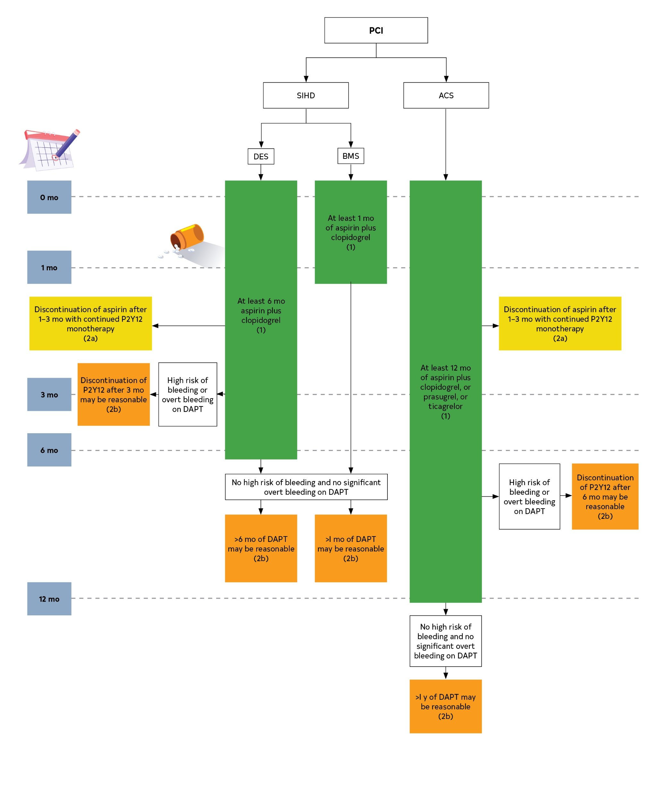
Figure 7. Use of DAPT for patients after PCI.
Colors correspond to Table 2.
ACS indicates acute coronary syndrome; BMS, bare metal stent; DAPT, dual antiplatelet therapy; DES, drug-eluting stent; P2Y12, platelet adenosine diphosphate P2Y12 receptor; PCI, percutaneous coronary intervention; and SIHD, stable ischemic heart disease.

Slide 117
Antiplatelet Therapy in Patients After CABG
Recommendations for Antiplatelet Therapy in Patients After CABG Referenced studies that support the recommendations are summarized in Online Data Supplement 45.
COR | LOE | Recommendations
1 | A | In patients undergoing CABG, aspirin (100–325 mg daily) should be initiated within 6 hours postoperatively and then continued indefinitely to reduce the occurrence of SVG closure and adverse cardiovascular events.
2b | B-R | In selected patients undergoing CABG, DAPT with aspirin and ticagrelor or clopidogrel for 1 year may be reasonable to improve vein graft patency compared with aspirin alone.

Slide 118
Beta Blockers in Patients After Revascularization
Recommendations for Beta Blockers in Patients After Revascularization Referenced studies that support the recommendation are summarized in Online Data Supplement 46.
COR | LOE | Recommendation
3: No benefit | C-LD | In patients with SIHD and normal left ventricular function, the routine use of chronic oral beta blockers is not beneficial to reduce cardiovascular events after complete revascularization.

Slide 119
Beta Blockers for the Prevention of Atrial Fibrillation After CABG
Recommendation for Beta Blockers for the Prevention of Atrial Fibrillation After CABG Referenced studies that support the recommendation are summarized in Online Data Supplement 47.
COR | LOE | Recommendation
1 | B-R | In patients after CABG, beta blockers are recommended and should be started as soon as possible to reduce the incidence or clinical sequelae of postoperative atrial fibrillation.

Slide 120
Antiplatelet Therapy in Patients With Atrial Fibrillation on Anticoagulation After PCI
Antiplatelet Therapy in Patients With Atrial Fibrillation on Anticoagulation After PCI Referenced studies that support the recommendations are summarized in Online Data Supplement 48.
COR | LOE | Recommendations
1 | B-R | In patients with atrial fibrillation who are undergoing PCI and are taking oral anticoagulant therapy, it is recommended to discontinue aspirin treatment after 1 to 4 weeks while maintaining P2Y12 inhibitors in addition to a non–vitamin K oral anticoagulant (rivaroxaban, dabigatran, apixaban, or edoxaban) or warfarin to reduce the risk of bleeding.
2a | B-R | In patients with atrial fibrillation who are undergoing PCI, are taking oral anticoagulant therapy, and are treated with DAPT or a P2Y12 inhibitor monotherapy, it is reasonable to choose a non–vitamin K oral anticoagulant over warfarin to reduce the risk of bleeding.

Slide 121
Recommendations for Addressing Psychosocial Factors and Lifestyle Changes After Revascularization

Slide 122
Cardiac Rehabilitation and Education
Recommendations for Cardiac Rehabilitation and Education Referenced studies that support the recommendations are summarized in Online Data Supplement 49.
COR | LOE | Recommendations
1 | A | In patients who have undergone revascularization, a comprehensive cardiac rehabilitation program (home based or center based) should be prescribed either before hospital discharge or during the first outpatient visit to reduce deaths and hospital readmissions and improve quality of life.
1 | C-LD | Patients who have undergone revascularization should be educated about CVD risk factors and their modification to reduce cardiovascular events.

Slide 123
Smoking Cessation in Patients After Revascularization
Recommendations for Smoking Cessation in Patients After Revascularization Referenced studies that support the recommendations are summarized in Online Data Supplement 50.
COR | LOE | Recommendations
1 | A | In patients who use tobacco and have undergone coronary revascularization, a combination of behavioral interventions plus pharmacotherapy is recommended to maximize cessation and reduce adverse cardiac events.
1 | A | In patients who use tobacco and have undergone coronary revascularization, smoking cessation interventions are recommended during hospitalization and should include supportive follow-up for at least 1 month after discharge to facilitate tobacco cessation and reduce morbidity and mortality.

Slide 124
Psychological Interventions in Patients After Revascularization
Recommendations for Psychological Interventions in Patients After Revascularization Referenced studies that support the recommendations are summarized in Online Data Supplement 51.
COR | LOE | Recommendations
1 | B-R | In patients who have undergone coronary revascularization who have symptoms of depression, anxiety, or stress, treatment with cognitive behavioral therapy, psychological counseling, and/or pharmacological interventions is beneficial to improve quality of life and cardiac outcomes.
2b | C-LD | In patients who have undergone coronary revascularization, it may be reasonable to screen for depression and refer or treat when it is indicated to improve quality of life and recovery.

Slide 125
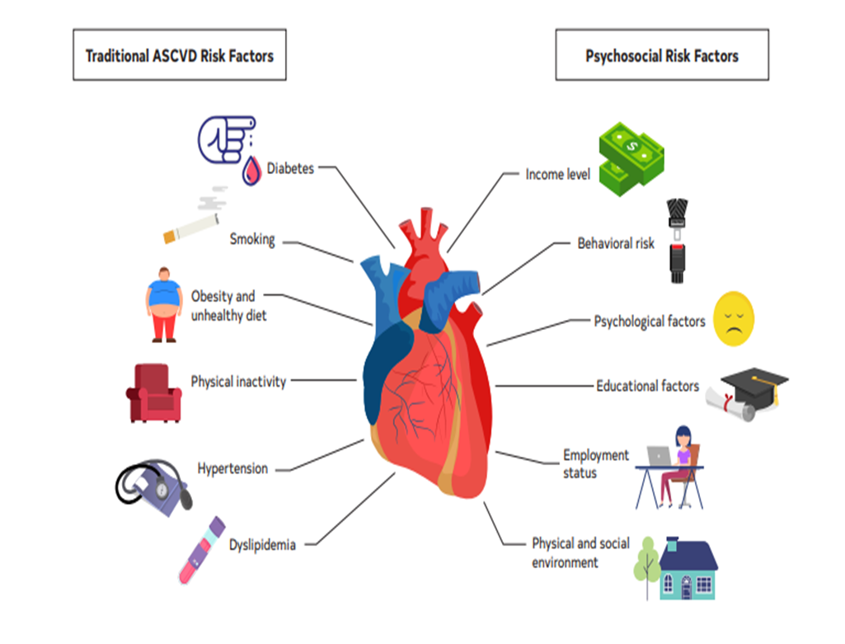
Figure 8. Traditional and nontraditional risk factors for CVD.
ASCVD indicates atherosclerotic cardiovascular disease; and CVD, cardiovascular disease.

Slide 126
Revascularization Outcomes

Slide 127
Assessment of Outcomes in Patients After Revascularization
Recommendations for Assessment of Outcomes in Patients After Revascularization Referenced studies that support the recommendations are summarized in Online Data Supplement 52.
COR | LOE | Recommendations
1 | B-NR | With the goal of improving patient outcomes, it is recommended that cardiac surgery and PCI programs participate in state, regional, or national clinical data registries and receive periodic reports of their risk-adjusted outcomes as a quality assessment and improvement strategy.
2a | C-LD | With the goal of improving patient outcomes, it is reasonable for cardiac surgery and PCI programs to have a quality improvement program that routinely 1) reviews institutional quality programs and outcomes, 2) reviews individual operator outcomes, 3) provides peer review of difficult or complicated cases, and 4) performs random case reviews.
2b | C-EO | Smaller volume cardiac surgery and PCI programs may consider affiliation with a high-volume centers to improve patient care.

Slide 128
Abbreviations used in this Guideline
Abbreviation | Meaning/Phrase
ACS | acute coronary syndrome
AKI | acute kidney injury
AMI | acute myocardial infarction
AVR | aortic valve replacement
BIMA | bilateral internal mammary artery
BMS | bare-metal stent
CABG | coronary artery bypass graft
CAD | coronary artery disease
CKD | chronic kidney disease
COR | Class of Recommendation
CTO | chronic total occlusion
CVD | cardiovascular disease
DAPT | dual antiplatelet therapy
DES | drug-eluting stent
ECG | electrocardiogram
FFR | fractional flow reserve
GDMT | guideline-directed medical therapy
iFR | instantaneous wave-free ratio
IMA | internal mammary artery
ISR | in-stent restenosis

Slide 129
Abbreviations used in this Guideline
IVUS | intravascular ultrasound
LAD | left anterior descending
LIMA | left internal mammary artery
LOE | Level of Evidence
MACE | major adverse cardiovascular events
MI | myocardial infarction
NSTE-ACS | non–ST-segment–elevation acute coronary syndrome
NSTEMI | non–ST-segment–elevation myocardial infarction
OCT | optical coherence tomography
PCI | percutaneous coronary intervention
RCT | randomized controlled trial
SCAD | spontaneous coronary artery dissection
SIHD | stable ischemic heart disease
STEMI | ST-segment–elevation myocardial infarction
SVG | saphenous vein graft
SYNTAX | Synergy Between PCI With TAXUS and Cardiac Surgery
TAVR | transcatheter aortic valve replacement
UFH | unfractionated heparin
VT | ventricular tachycardia

